Slide 1

Wi-Fi enabled Obstacle Avoiding Robot
Module
Rohit Kumar

Slide 2
Contents
Title | Page
Introduction
Hardware Required
Description
Ultrasonic Sensor
Obstacle Avoiding Robot Algorithm
Connecting ESP8266 to Local XAMPP server
Creating Database and table
Setup connection with database
Accessing data in phpMyAdmin Database

Slide 3
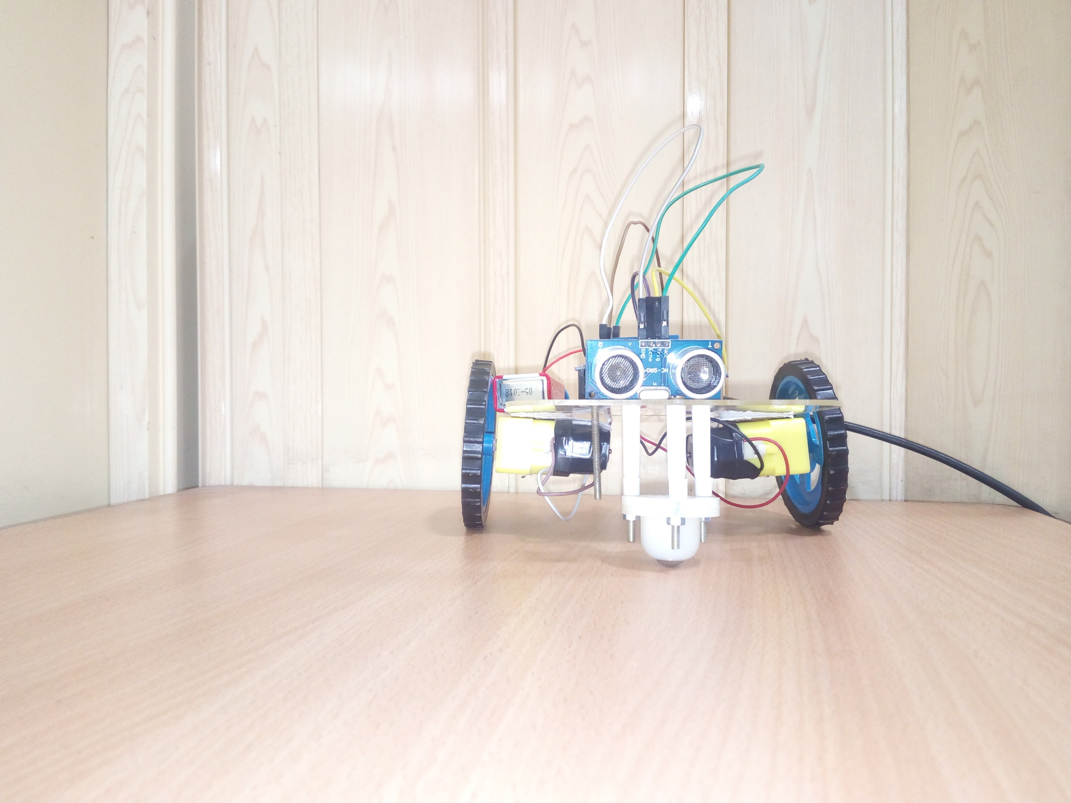
Obstacle Avoiding Robot
The obstacle avoiding robot is used for detecting obstacles and avoiding the collision.

Slide 4
Hardware requirements
Arduino Uno
ESP8266 Wi-Fi module
Ultrasonic sensor (HC SR04)
DC Motor Driver L293D
DC Motor
Power Supply

Slide 5
Description
Here we are going to implement a Wi-Fi enabled robot which is going to detect obstacle and according to that, it going to change its direction.
Now first we are going to connect ultrasonic sensor with our Arduino board. Then according to program our ultrasonic sensor going generate a trigger signal which is going receive by our echo pin of Ultrasonic sensor.
Then we are going to run an algorithm according which we are going to manipulate our desire distance for obstacle detection then we are going to control our motor rotation direction for movement of our robot. And send the distance measured by ultrasonic sensor to phpMyAdmin database.

Slide 6
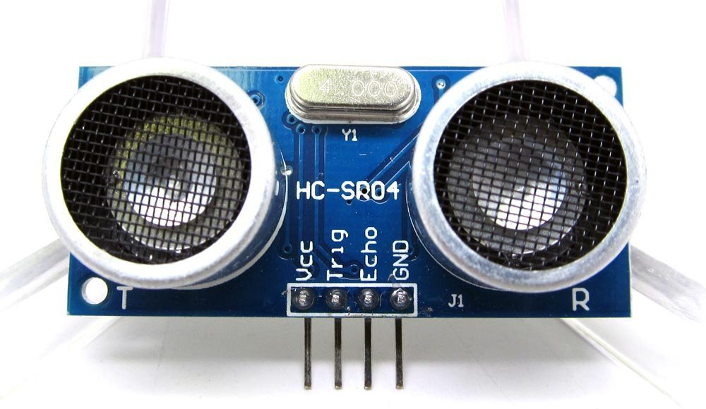
Ultrasonic Sensor
Ultrasonic transmitter emitted an ultrasonic wave in one direction, and started timing when it launched. Ultrasonic spread in the air, and would return immediately when it encountered obstacles on the way. At last, the ultrasonic receiver would stop timing when it received the reflected wave. As Ultrasonic spread velocity is 340m / s in the air, based on the timer record t, we can calculate the distance (s) between the obstacle and transmitter, namely: s=340t/ 2, which is so- called time difference distance measurement principle.

Slide 7
Electrical parameters
Electrical Parameters | HC-SR04 Ultrasonic Module
Operating Voltage | DC-5V
Operating Current | 15mA
Operating Frequency | 40KHZ
Farthest Range | 4m
Nearest Range | 2cm
Measuring Angle | 15 Degree
Dimensions | 45*20*15mm

Slide 8
Obstacle avoiding robot

Slide 9
Connecting ESP8266 to Local XAMPP server
Now we connect our Arduino with ESP8266 Wi-Fi module to send data to database wirelessly.
Then we have to install XAMPP server so that we can use local server for transmission of data and also able to create MySQL database to save value.
Go to this link for installation of XAMPP server :- https://www.apachefriends.org/index.html

Slide 10
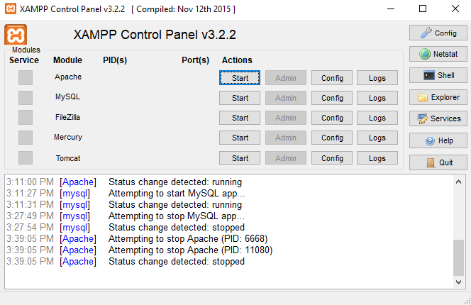
After installation of XAMPP you will get this window:-

Slide 11
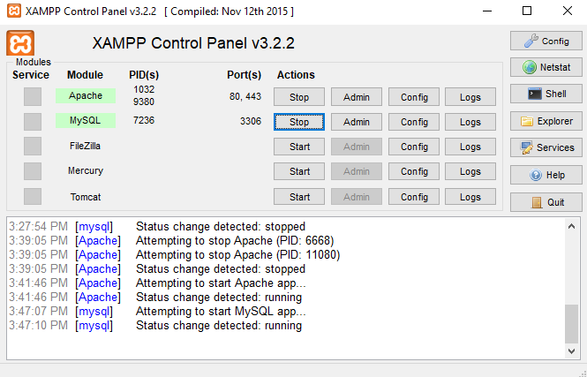
Start the Apache and MySQL module
Click on Netstat to note the IP address used by server.

Slide 12
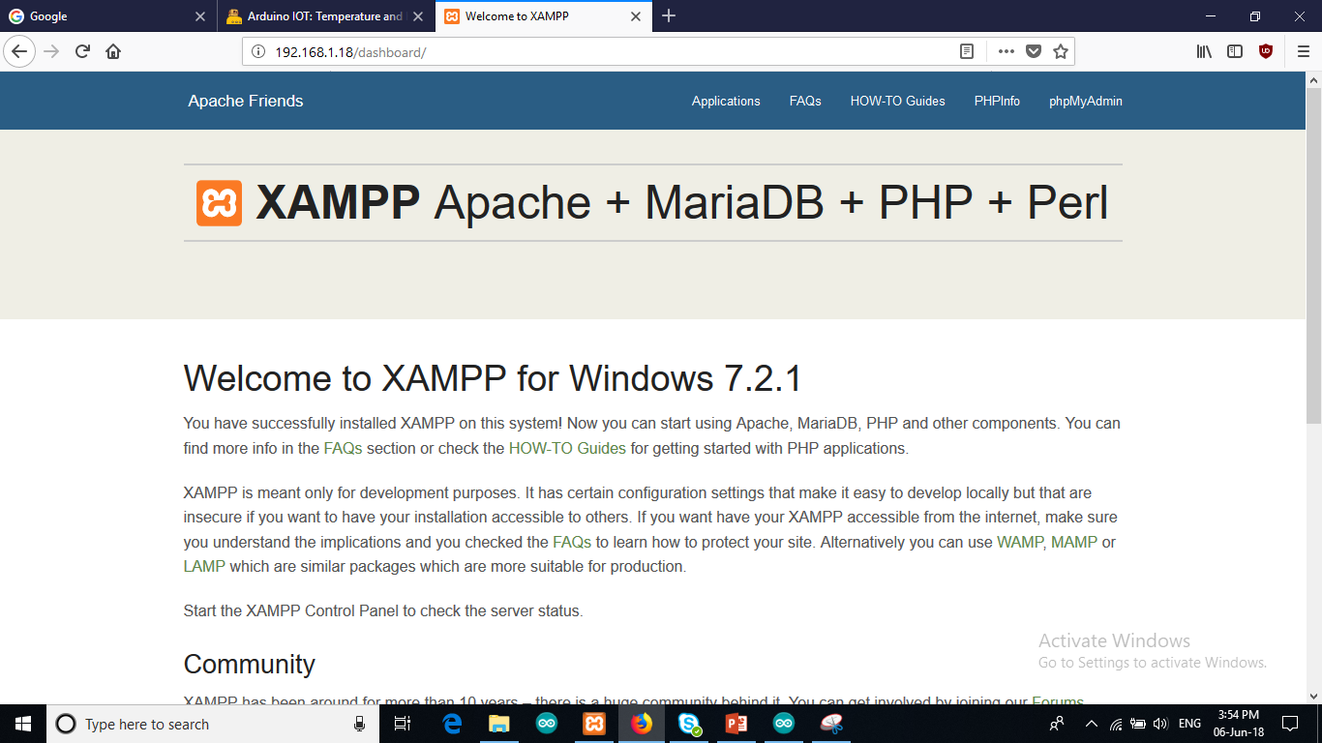
Type this IP address in your browser
Then you will get dashboard of XAMPP.
Click on phpMyAdmin.
Now you will get a screen where you can create your database.

Slide 13
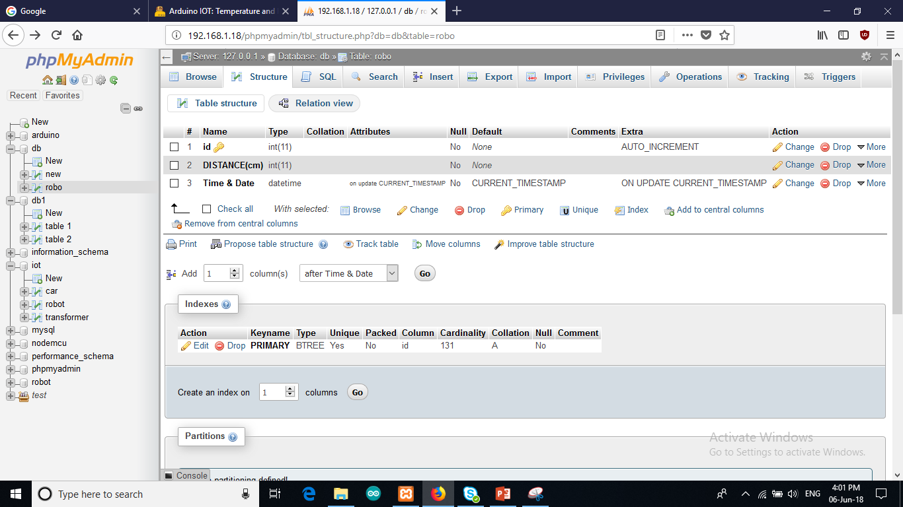
Click on New tab -> Enter the name of database and then click on create.
Now enter the name of table and set no. of columns to 3.
Fill the entries in columns same as image above.
Now we are done with database.

Slide 14
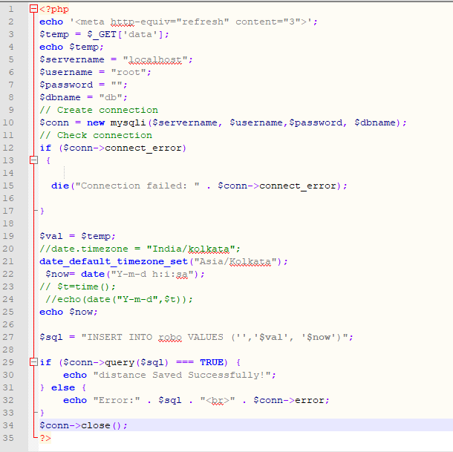
Setup connection with database
In this php code we are establishing connection with database to send value to database.
You need to set your username, password, dB name, and table name same as you created.

Slide 15
Final Setup
Now open Arduino IDE.
Select board as Arduino Uno
And select your port.
Open your code file and upload the code in Arduino.
Now open your serial monitor check whether you are getting the right output or not.
Then open your browser enter : <ipaddress>/yourphpfile.php
Now when you open your phpMyAdmin database you will get the distance measured by sensor.

Slide 16
Thank You !
Contact US
Nitin Sinha
nitin.sinha@goSigmaWay.com
+1 727-394-4375
+91 7838188809
Debjani Mitra
debjani.mitra@goSigmaWay.com
+1 952-583-3449
+91 9339555636
Rohit Kumar
rohit.kumar@sigmaway.us
+91 7982577830
+91 7838021754

